Slide 1
Financial Risk Detection
Domain: Banking

Slide 2
Introduction:
This project aims to leverage Exploratory Data Analysis (EDA)
and machine learning to conduct risk analysis for loan default
prediction in the context of a consumer finance company. By
analyzing historical loan application data, we will identify patterns
and factors that indicate whether a client is likely to default on their
loan payments. This analysis will assist the company in minimizing
financial losses while ensuring that creditworthy applicants are not
unfairly rejected.

Slide 3
Business Understanding
The lending industry faces significant challenges in assessing
creditworthiness, particularly for applicants with limited or no
credit history. Loan defaults pose financial risks to lending
institutions, making accurate risk assessment crucial. Our
primary objective is to use EDA and machine learning
techniques to understand the drivers behind loan default and
develop strategies to mitigate these risks effectively.

Slide 4
Business Objectives
Identify patterns indicating clients' difficulty in repaying loans through
detailed analysis of application data.
Determine the key demographic, financial, and credit-related factors
that influence loan default using machine learning models.
Utilize insights gained from the analysis to inform portfolio
management, risk assessment, and lending practices.
Develop strategies to minimize financial losses due to loan defaults
and optimize lending decisions.

Slide 5
Tools Used
Python
Pandas
Matplotlib
Seaborn
Numpy
Scklean

Slide 6
Approaches
Data extraction
Data Preprocessing
EDA
Feature Engineering
Model building
Conclusion

Slide 7
Data extraction & Preprocessing
This Dataset contains actually in two different parts.
1. Previous application
2. Current application where Target is located. Previou_application_size: (1670214, 37) application_data_size: (307511, 122) Target variable (1 - client with payment difficulties: he/she had late payment more than X days on at least one of the first Y instalments of the loan in our sample, 0 – Non Difficulties)

Slide 8
Data Pre-processing part - 1
Handling Null values:
Theoretically, 25 to 30% is the maximum missing values are allowed, beyond which we might want to drop the variable from analysis. But practically we get variables with ~50% of missing values but still, the customer insists to have it for analysing. In those cases, we have to treat them accordingly. Here, we will remove columns with null values of more than 35% after observing those columns.
Shape of application_data_size after removing Null columns: (307511, 73)
Shape of previous_application_size after removing Null columns: (1670214, 33)

Slide 9
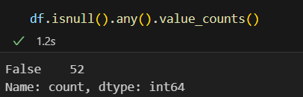
Data Pre-processing part - 1
In pre-processing part 2, I have intentionally merged two DataFrames into one using Inner method.
After merging, I can see some Null values. Since we have large number of instances, I have dropped those null values.
After treating Null values, we can see that there was no null values.

Slide 10
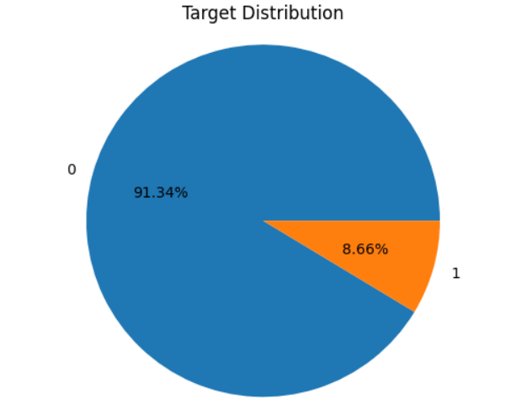
Exploratory Data Analysis
Before start analysing Data, Checked the data imbalance. Its very important step to check in Machine learning or Deep learning.
While checking, we can found that, Target 1 and 0 had huge difference.
Imbalance data ratio is 11.3

Slide 11
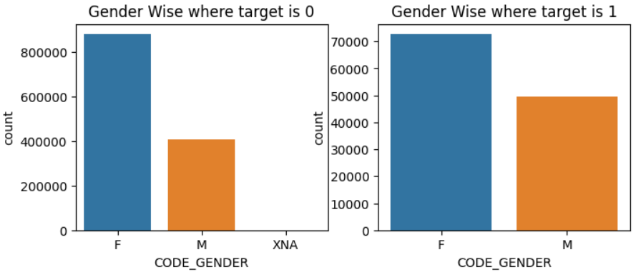
Splitting the analysis based on Target variable for better understanding!!
Starts with the Gender wise analyses on Target 1 & 0 which is defaulter and Non defaulters!!
Insights:
Females had contributed more on both whereas if it was Defaulters or Non Defaulters in general!! Lets see other factors in upcoming slides---

Slide 12
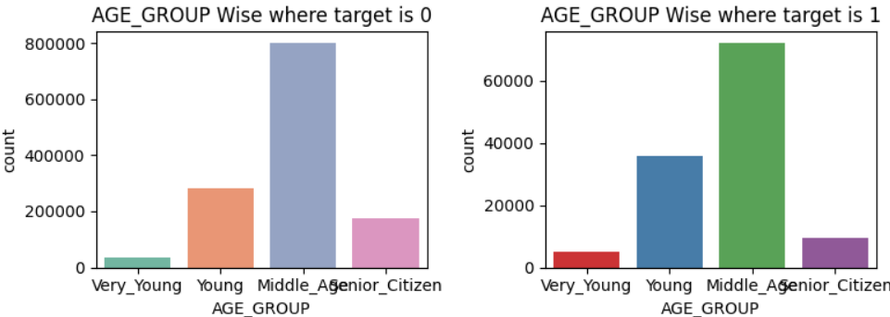
AGE wise effects on Targets!!
Insights:
Middle age groups person like age between 35 to 40 aged group members were applying high in loans, followed by Young People.
In which, Middle and Young age persons were facing difficulties in paying loan

Slide 13
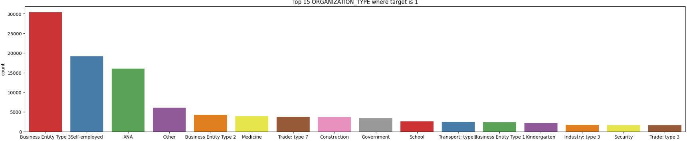
Organization distribution
Insights from Organization factor:
It found that Business, Self-employed groups seeking for loans – In which they were facing some difficulties too. PFB, top 15 defaulters Org.

Slide 14
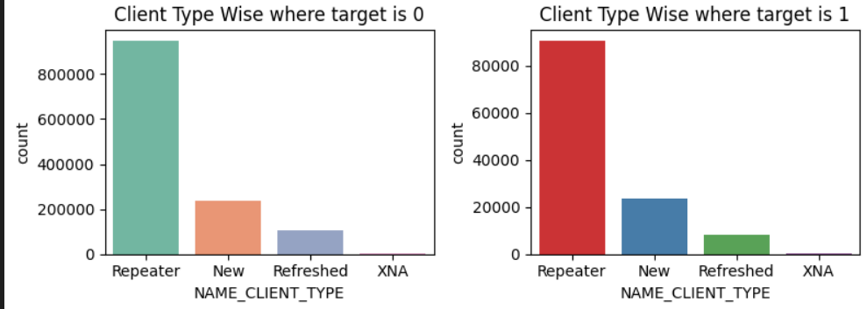
Type of Clients in Non-defaulters
While coming to Client wise, we have clients like Repeated Clients, New clients, Refreshed clients.
Repeated Clients in the range of above 8000 were defaulters in paying the loan at on time.

Slide 15
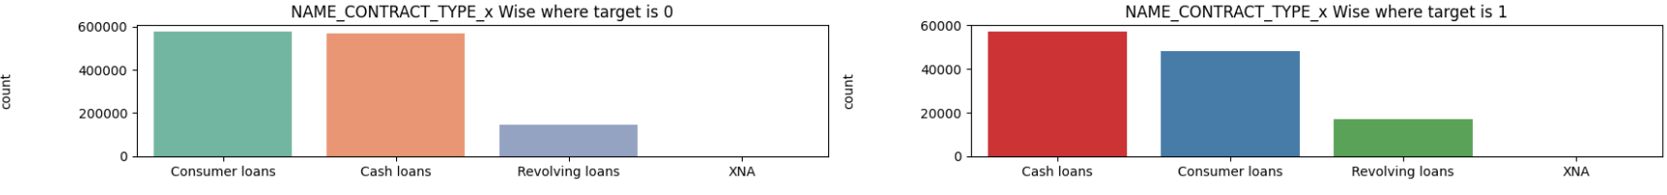
Loan type and its information
In terms of loans types, we have Consumer loans, Cash loans, Resolving loans and XNA.
In which Cash loans are the most defaulters loans. So, its remedial measure, we can find alternative for Cash loans.

Slide 16
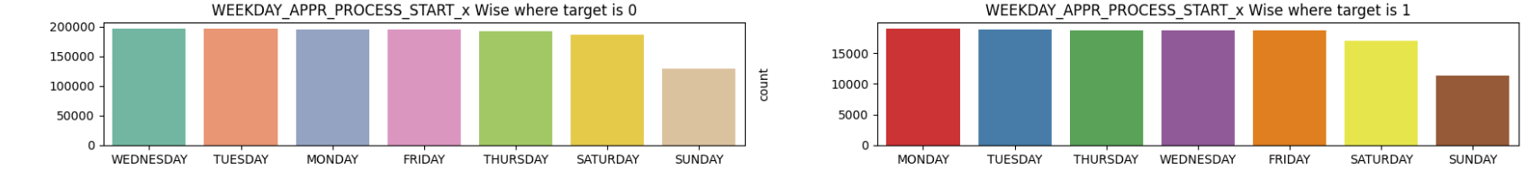
Week-day distribution on defaulters and Non defaulters
Distribution looks more similar to defaulter & Non defaulters, however there was a slight difference on Saturday and Sunday On Non defaulters side.

Slide 17
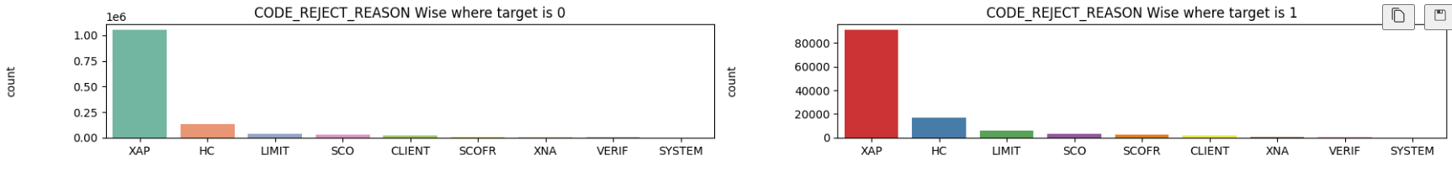
Rejection reason for Loan application
In code rejection reasons we have reasons on XAP, HC, LIMIT, SCO, SCOFR terms.
In which XAP, HC had high in Defaulters side.

Slide 18
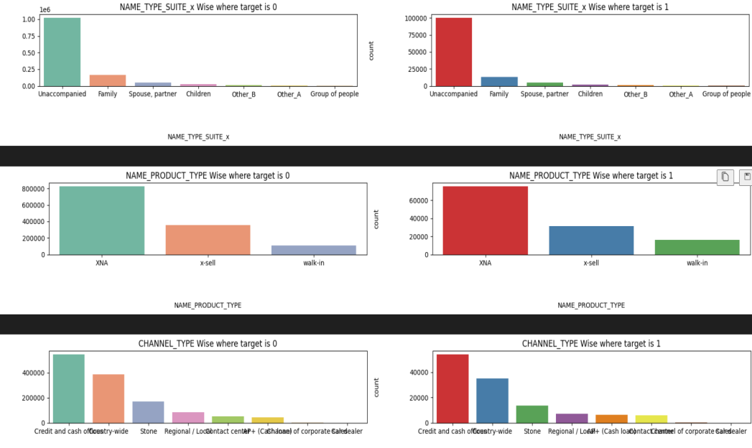
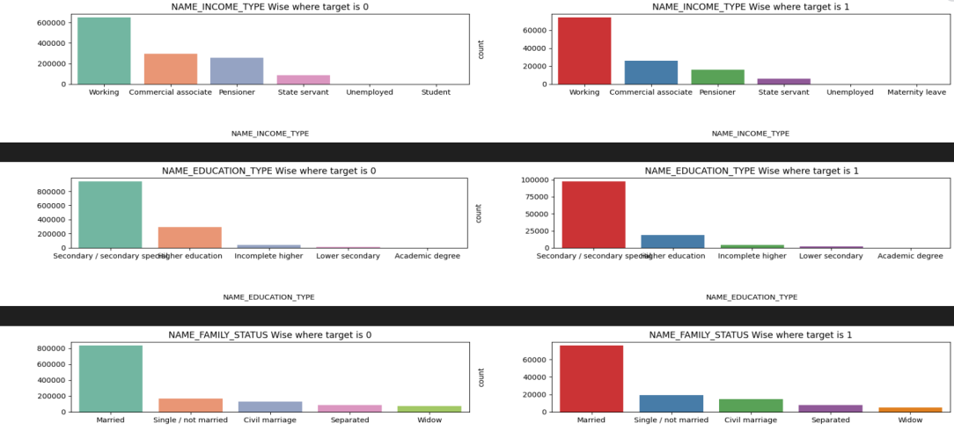
Other factors on Defaulter’s side
There are more factors in our data which falls on defaulter’s side.
Following Insights on –
Insights:
Contract_Type: In this, Cash loans were not paid ontime on loan dues while comparing to consumer loans and cash loans.
Payment_type: Cash through bank had high contribution and users prefer for cash through bank. Also, cash through bank had high difficulties in repaying loan
Name_type_suite: Unaccompanied, family, Spouse, children are the major in getting loans and in which Unaccompanied had high marging in difficult in paying loans.
Name_product_type: XNA, X-sell, walk-in are the major contribution in getting loans and repaying loans.
Channel_Type: Credit and cash, country_wide are the playing huge role in difficult
Flag_own_car - Clients who had No car, seeking for loans while comparing to others and we can see some difficulties in repaying.
Name_income_Type: Clients on working, commercial associate, Pensioner, state servant had asking loans. In this, Working professional had some difficult in repaying the loans while comparing to others.
General insights:
Married clients, House types like house / apartment, were high in getting loans and there were some difficult in paying the loans too.
PFB, the chat representation:

Slide 19
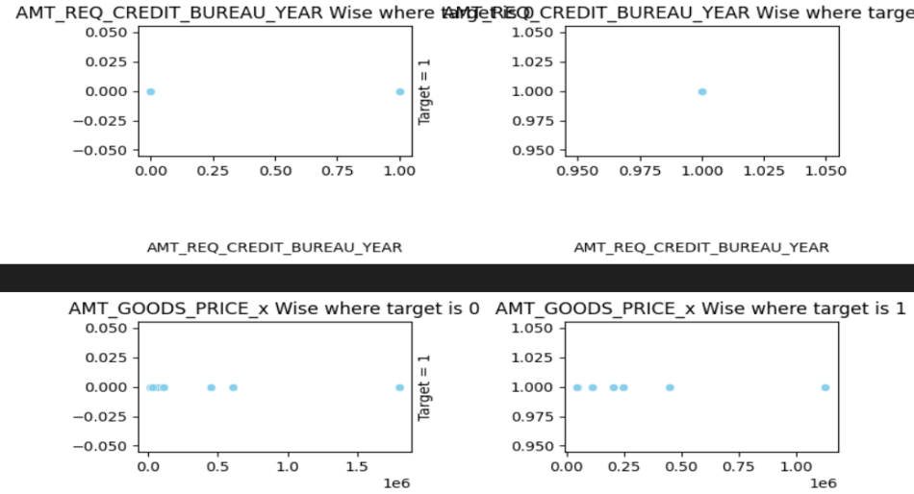
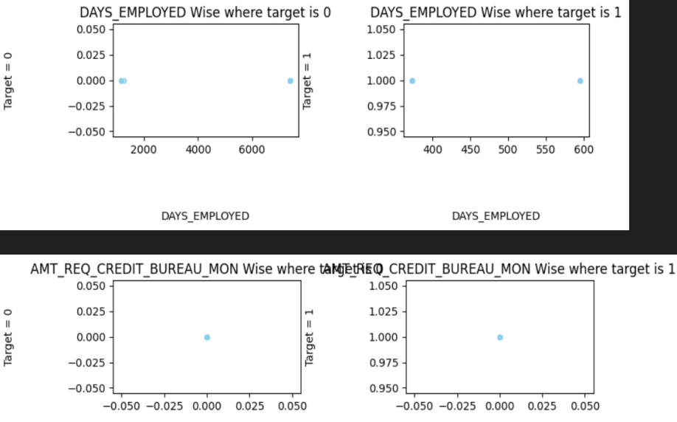
Analysis of Numerical factors & its distribution
Insights
People with target one has largely staggered income as compared to target zero. Scatter plot clearly shows that the shape in Income total, Annuity, Credit and Good Price is similar for Target 0 and similar for Target 1.
The plots are also highlighting that people who have difficulty in paying back loans with respect to their income, loan amount, price of goods against which loan is procured and Annuity.
Also, all these graphs shows there was neutral relation between the targets which included the days of employed too.

Slide 20
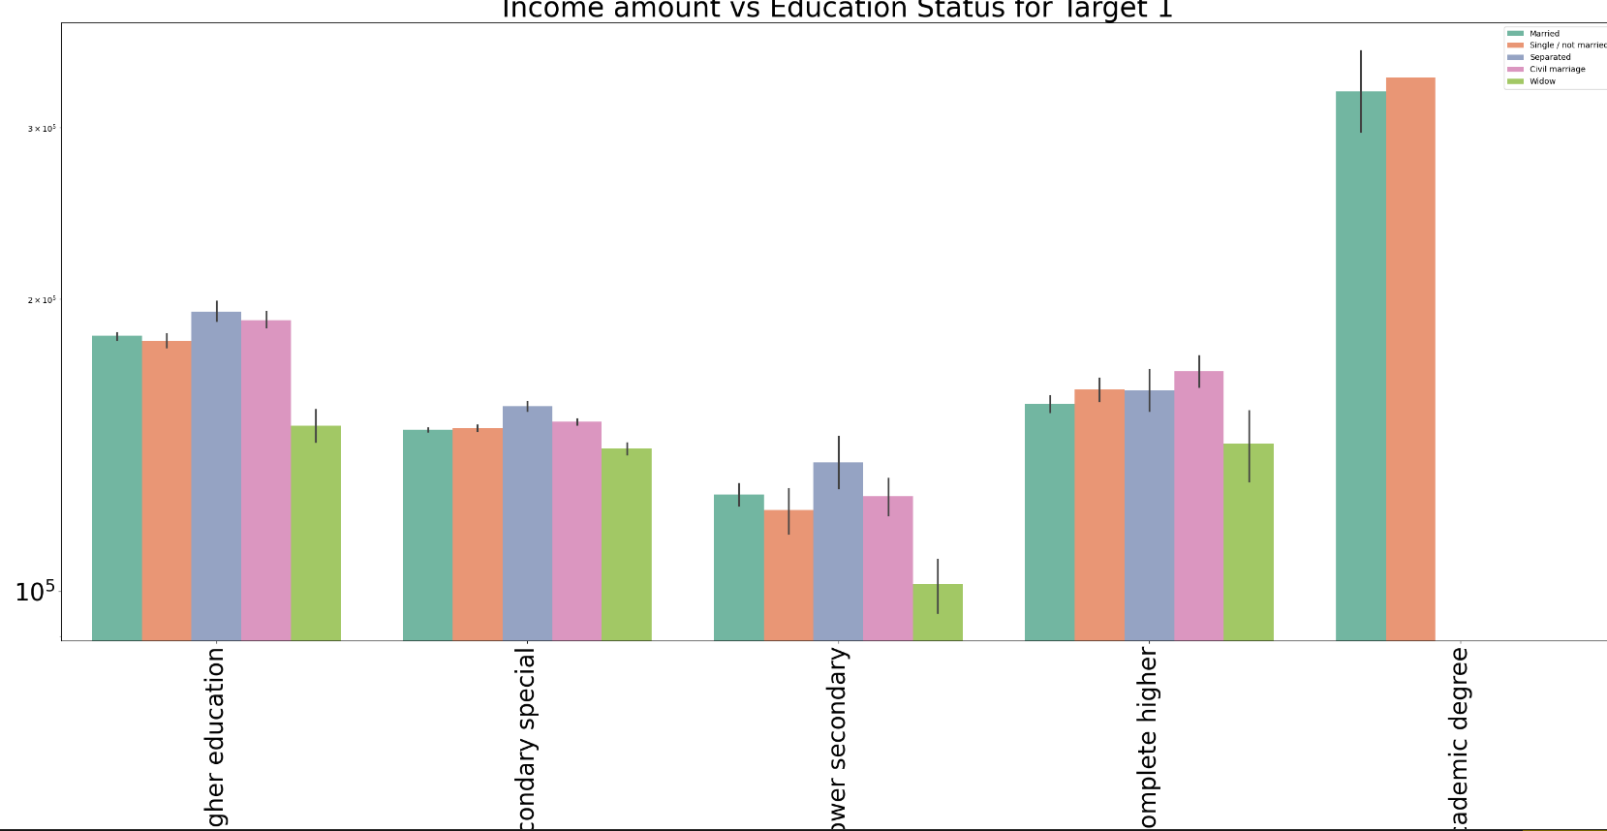
Bivariate Analysis: Numerical & Categorical
Lets start with the Annual Income, Education, Family status!!
Insights: Non Defaulters- Upon seeing that Single / Not married, married shows some difficulties in paying loans in Academic degree even they getting high Annual Income. In second place, clients with Higher education in all categories like Married, single, Widow were showing some difficulties in paying loans. So, we can suggest Single & married on academic degree and lesser the education clients were facing some difficulties in paying loan.

Slide 21
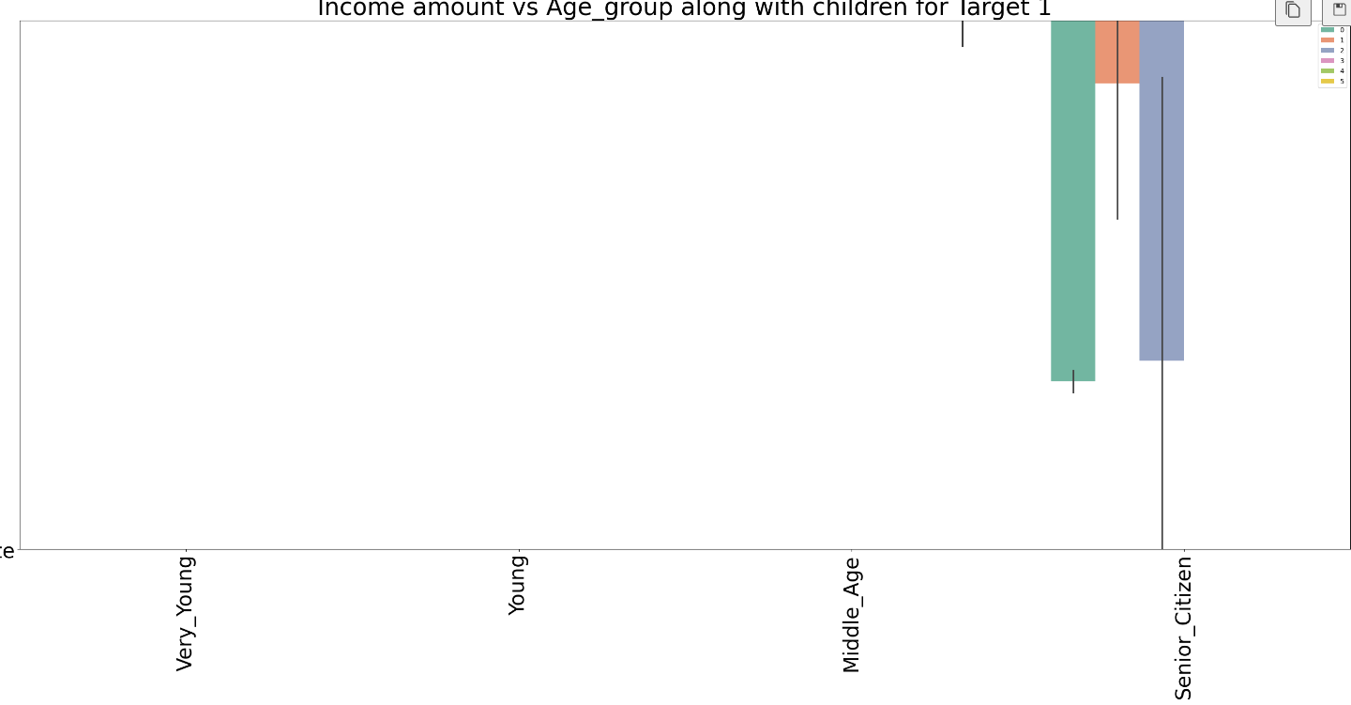
Let’s check the Age_group on Income type for Defaulters!
Insights: Senior citizen clients with children above 3 have high Annual income and good in paying loans. Middle aged clients also shows same with senior citizen but some less Annual income while comparing to senior citizen. When coming to vey young clients, we can see there had no children above 3. Upon these analysis, clients with no children shows good in paying loan. Senior citizen with no children and up to children were not good at paying loans. Also, upon checking, other categories had no defaulters in paying the loans in terms of children.

Slide 22
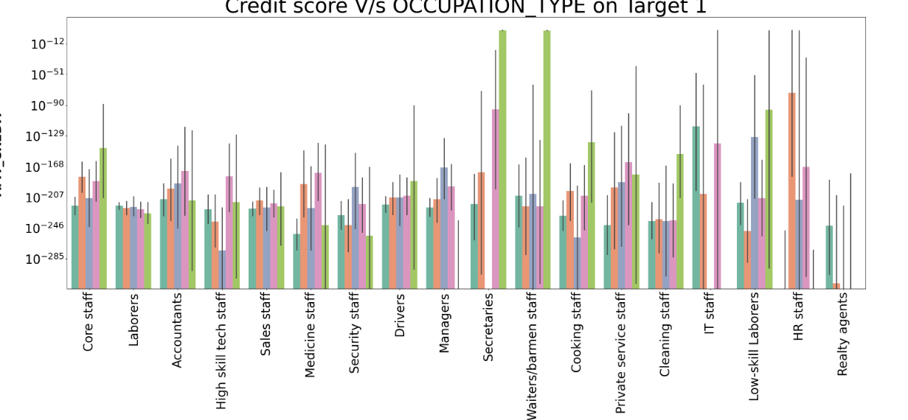
Credit Score VS Occupation types
In occupation types, we have Core staff, Labourers, Accountants, Sales staff, Drivers, IT-Staffs and etc.
In which Clients working on secretaries, IT staffs, HR staffs had high credit score and they are good at paying their loans at on times, there was no difficulties in their payment.

Slide 23
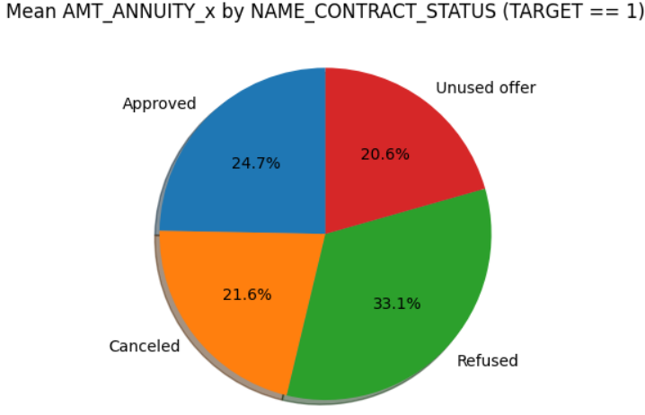
AMT Annuity & Contract status
Insights:
Upon analysing, we can found that 24% loans were approved and 21% were cancelled. It seems that 33% were refused by Clients.

Slide 24
More insights from further analysis
Insights
AMT_CREDIT is inversely proportional to the DAYS_BIRTH , peoples belong to the low-age group taking high Credit amount and vice-versa
AMT_CREDIT is inversely proportional to the CNT_CHILDREN, means the Credit amount is higher for fewer children count clients have and vice-versa.
AMT_INCOME_TOTAL is inversely proportional to the CNT_CHILDREN, means more income for fewer children clients have and vice-versa.
fewer children clients have in a densely populated area.
AMT_CREDIT is higher in a densely populated area.
AMT_INCOME_TOTAL is also higher in a densely populated area.

Slide 25
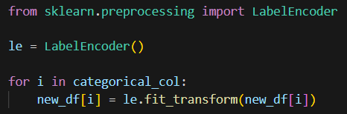
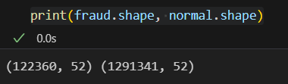
Encoding & Model Building
As we noted, that this dataset was highly imbalanced, I have used subset and scaling method for better results.
The number of instances where the 'TARGET' column has a value of 0 is significantly larger (1,291,341 instances) than the number of instances where the 'TARGET' column has a value of 1 (122,360 instances).
Also, Used Label encoder method to encoding the categorical columns to Numerical columns

Slide 26

Model Building
Used one package for imbalance dataset, here for better result and create a pipe line for under sampling and oversampling.
Also, tried with several Classification algorithms and we can see most of the algorithms giving above 90 as accuracy, also checked with confusion matrix for evaluation.

Slide 27
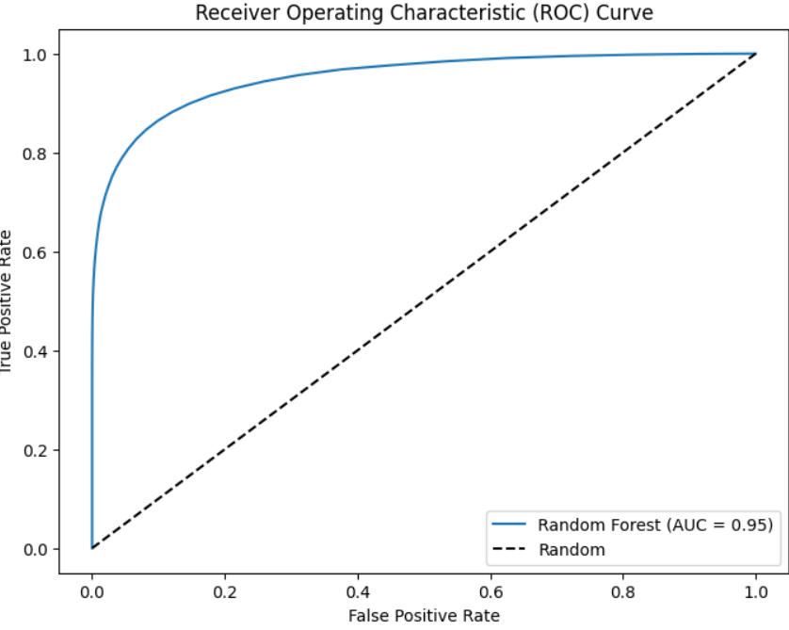
ROC Curve:
AUC stands for "Area under the ROC Curve." That is, AUC measures the entire two-dimensional area underneath the entire ROC curve (think integral calculus) from (0,0) to (1,1).
Higher the AUC, then the model is generalized model.

Slide 28
Solution & Conclusion
The analysis conducted on the financial risk assessment project has yielded valuable insights that can aid in minimizing financial losses due to loan defaults and optimize lending decisions. Here are key findings and conclusions:
Educational and Employment Patterns:
No significant patterns were observed in educational or employment backgrounds that directly correlate with higher default risk.
It's crucial to consider a holistic view of the client's financial profile rather than relying solely on educational or employment factors.
Client Profiles and Payment Difficulties:
Distinct differences exist in client profiles between those experiencing payment difficulties and those without.
Certain demographic factors, family status, and income types contribute to variations in payment difficulties.
Income to Debt Ratio:
Calculating the Income to Debt ratio is essential to understanding a client's financial health.
Clients with higher income to debt ratios are generally more financially stable and have lower default risk.
Relationship Between Income, Debt, and Default Probability:
A clear relationship exists between income levels, debt amounts, and the probability of loan default.
Clients with high debt relative to their income are more likely to face difficulties in repaying loans.
Income Distribution Among Loan Applicants:
Analyzing income distribution among loan applicants is crucial for assessing the financial diversity of the client base.
Income distribution influences loan amounts and approval rates, impacting the overall risk profile.
Loan Amounts vs. Income Levels:
There is a need to carefully evaluate the loan amount requested by clients in relation to their income levels.
Assessing the client's ability to repay in proportion to the loan amount is essential for mitigating default risks.

Slide 29
Recommendations
Recommendations for Optimizing Lending Decisions:
Implement a robust Income to Debt ratio calculation during the loan approval process to assess the client's financial health accurately.
Consider a holistic approach, taking into account various demographic factors, family status, and income types for a comprehensive risk assessment.
Regularly review and update lending policies based on ongoing data analysis to adapt to changing economic conditions.
Utilize machine learning models to predict loan default probabilities and enhance decision-making processes.
Provide financial education resources to clients with potential risk factors to empower them to manage their finances effectively.
By addressing these aspects and implementing data-driven strategies, the lending institution can optimize lending decisions, reduce default risks, and make informed financial decisions.

